Slide 1

Lecture 1: Introduction
Assaf Shocher
assafshocher@gmail.com

Slide 2
Overview
What is machine learning?
Use cases
Types of ML
Supervised learning- an example
Supervised learning- framework and terminology
Linear regression?
Recommend resources:
Shai Shalev-Shwartz: Understanding Machine Learning: From Theory to Algorithms
Andrew NG: CS229 Lecture notes

Slide 3
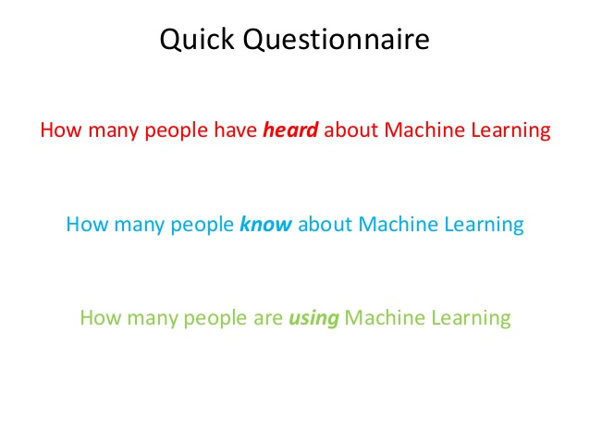

Slide 4
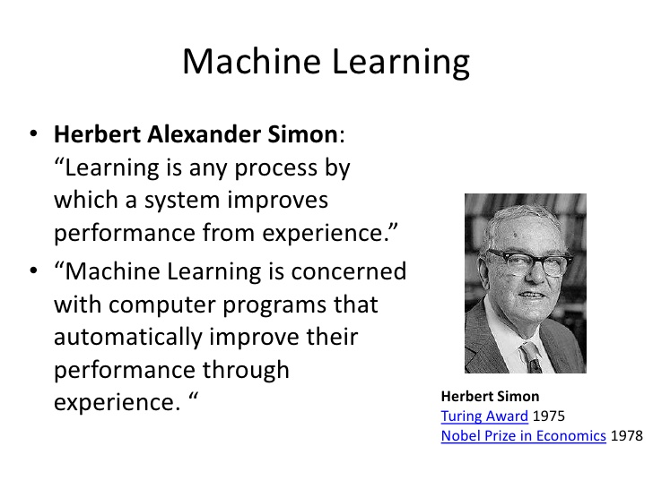

Slide 5


Slide 6
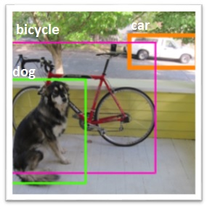
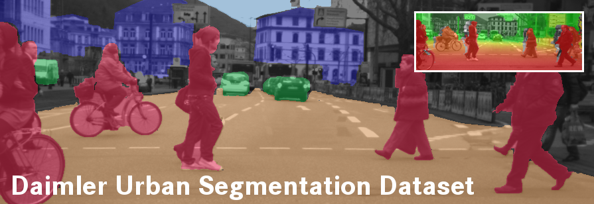

Slide 7

ML Models:
GMM
HMM
Language-Models

Slide 8


ML Models:
MM
RNN

Slide 9
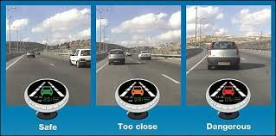
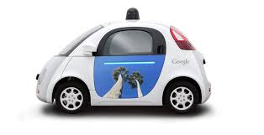

ML Models:
Deep Learning
Convolutional Neural Nets

Slide 10


Slide 11
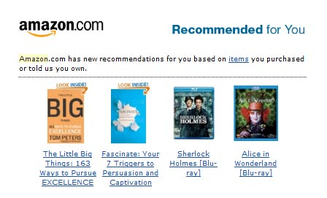

Slide 12

ML Models:
Convolutional neural nets
PCA

Slide 13

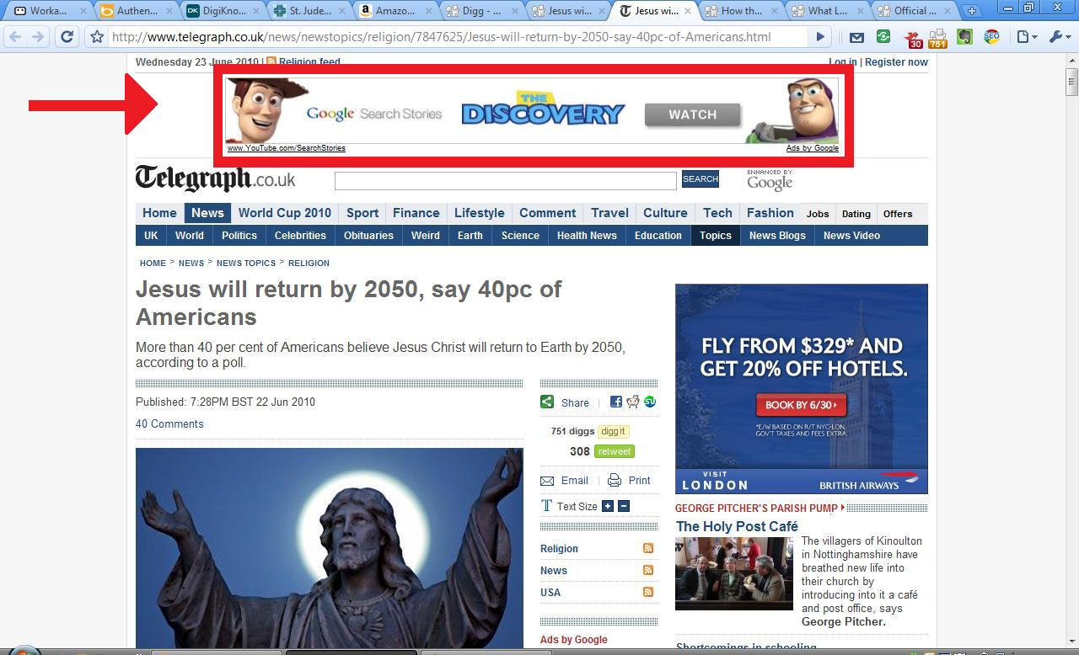

Personalized Advertising in Real-Time

Slide 14



Slide 15

Personalized HealthCare

Slide 16

Attacks and Malware prediction

Slide 17

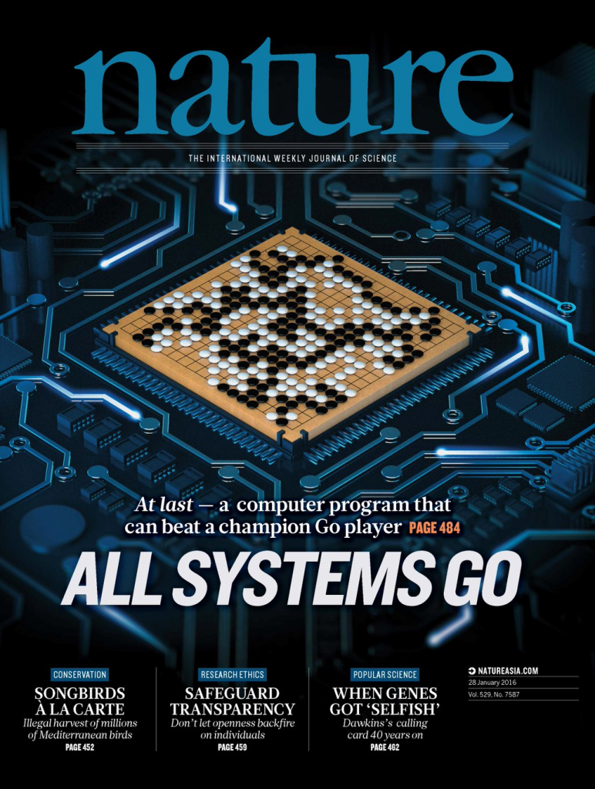
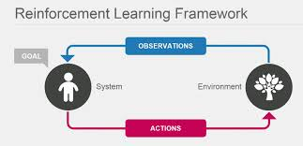

Slide 18


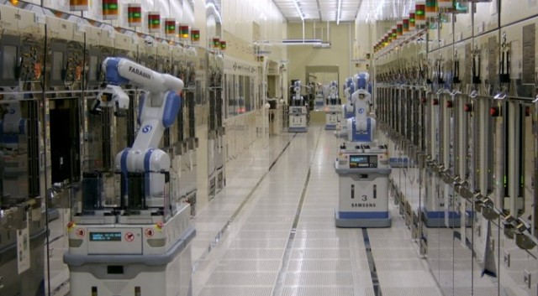

Slide 19
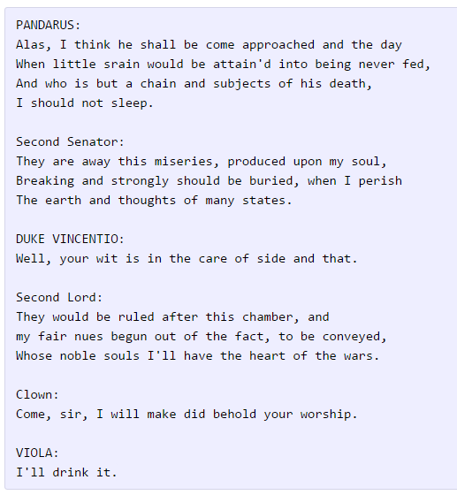

Slide 20
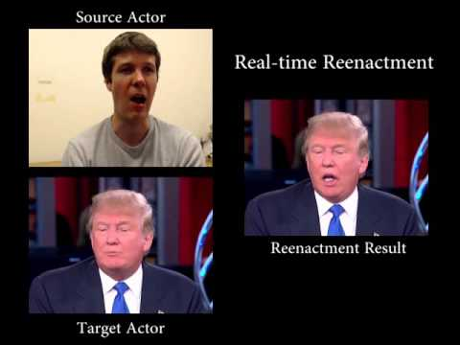

Slide 21
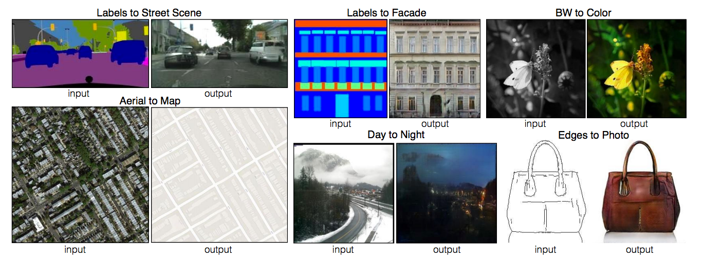

Slide 22
Fields using ML
Computer vision
Natural Language Processing
Speech recognition
Data mining
Recommender Systems
Spam detection
Cyber security
Bio-med
Neuroscience

Slide 23
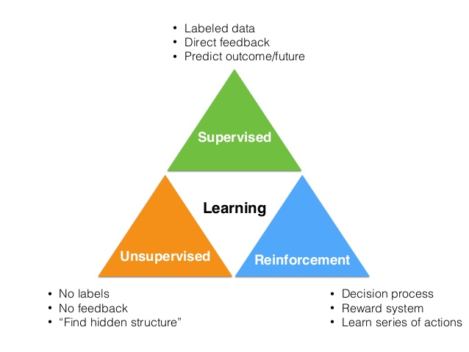
Types of ML
Supervised learning
Unsupervised learning
Reinforcement learning

Slide 24
Challenges
Classification
Regression
Clustering
Dimensionality reduction

Slide 25
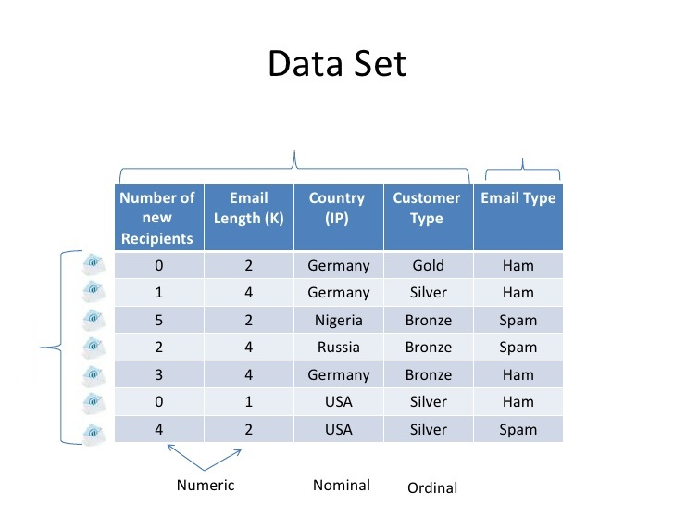
Supervised learning- an example
Spam detection

Slide 26
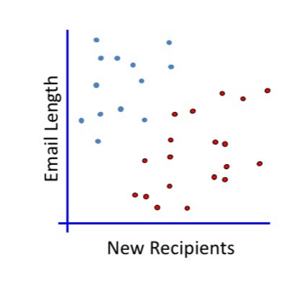

Slide 27
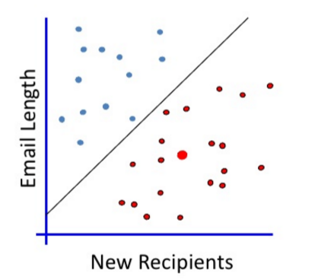

Slide 28
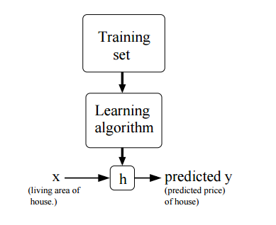
Supervised Learning Framework *
Training input: x_i
Terms of the vec x are called “features”
Training labels: y_i
Hypothesis: h(x) = y
Hypothesis class: H = {h_1, h_2 … }
Cost / Loss / Risk: L
Learning algorithm: A(X,Y) = h
Empirical risk and true risk: L_d, L_s

Slide 29
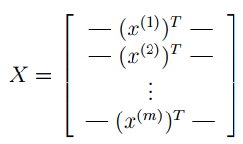
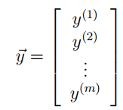

Slide 30
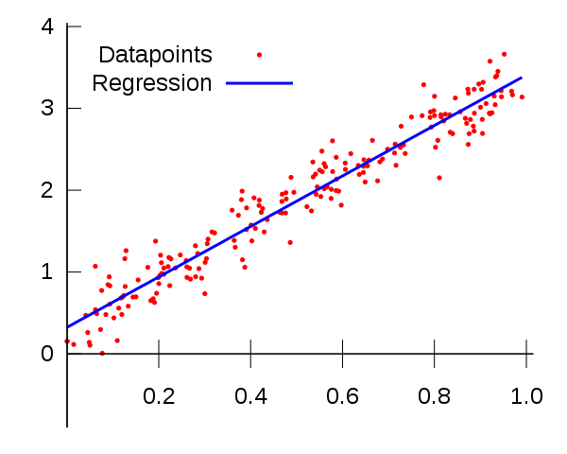
Linear regression

Slide 31
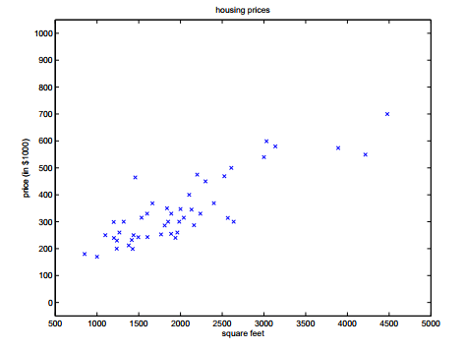
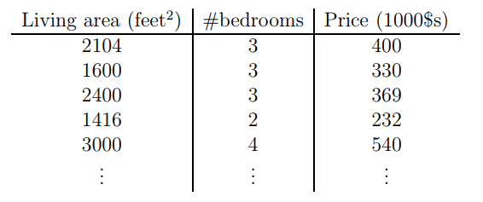
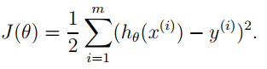

Slide 32
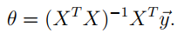
Normal equations

